Slide 2
What Is the Problem of the K-Means Method?
The k-means algorithm is sensitive to outliers !
Since an object with an extremely large value may substantially distort the distribution of the data.
K-Medoids: Instead of taking the mean value of the object in a cluster as a reference point, medoids can be used, which is the most centrally located object in a cluster.
10
10
9
9
8
8
7
7
6
6
5
5
4
4
3
3
2
2
1
1
0
0
1
2
3
4
5
6
7
8
9
10
0
0
1
2
3
4
5
6
7
8
9
10

Slide 3
2. The K-Medoids Clustering Method
Find representative objects, called medoids, in clusters. Most centrally located objects in a cluster.
PAM works effectively for small data sets, but does not scale well for large data sets
PAM (Partitioning Around Medoids)
To find k clusters from n objects – Arbitrarily find a representative objects (medoids) for each cluster.
Each remaining object is clustered with medoid to which it is most similar.
starts from an initial set of medoids and iteratively replaces one of the medoids by one of the non-medoids as long as quality of of the resulting clustering is improved.
Each time a reassignment occurs, Quality is estimated using a COST FUNCTION that measures avg disimilarity b/w objects and medoid of its cluster.
COST FUNCTION- difference in square error value if a current medoid is replaced by a non-medoid object
Total Cost of Swapping- the sum of cost incurred by all non medoid objects.

Slide 4
The K-Medoids Clustering Method
Find representative objects, called medoids, in clusters. Most centrally located objects in a cluster.
To find k clusters from n objects – Arbitrarily find a representative objects (medoids) for each cluster.
Each remaining object is clustered with medoid to which it is most similar.
starts from an initial set of medoids and iteratively replaces one of the medoids by one of the non-medoids as long as quality of of the resulting clustering is improved.
Each time a reassignment occurs, Quality is estimated using a COST FUNCTION that measures avg disimilarity b/w objects and medoid of its cluster.
COST FUNCTION- difference in square error value if a current medoid is replaced by a non-medoid object
Total Cost of Swapping- the sum of cost incurred by all non medoid objects.
If Total cost<0; swap Oj and Orandom. If +ve ; current medoid (Oj) is considered acceptable.
Then assign each non-selected object to the most similar representative object.

Slide 5
K-Medoids (also called as Partitioning Around Medoid) algorithm was proposed in 1987 by Kaufman and Rousseeuw.
A medoid can be defined as the point in the cluster, whose dissimilarities with all the other points in the cluster is minimum

Slide 6
Algorithm
1. Initialize: select k random points out of the n data points as the medoids. 2. Associate each data point to the closest medoid by using any common distance metric methods. 3. While the cost decreases: For each medoid m, for each data o point which is not a medoid: 1. Swap m and o, associate each data point to the closest medoid, recompute the cost. 2. If the total cost is more than that in the previous step, undo the swap.

Slide 7
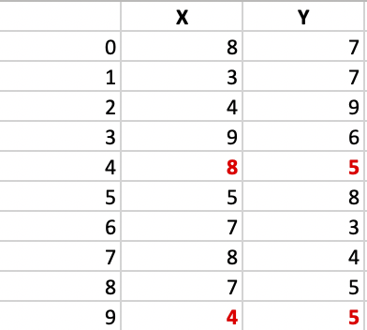

Slide 8
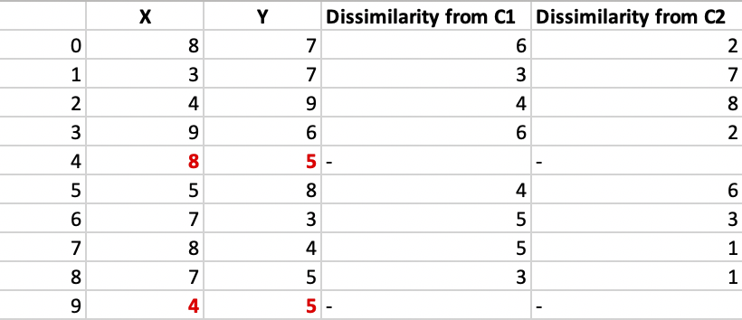
Step 1: Let the randomly selected 2 medoids, so select k = 2 and let C1 -(4, 5) and C2 -(8, 5) are the two medoids.
Step 2: Calculating cost. The dissimilarity of each non-medoid point with the medoids is calculated and tabulated:
Each point is assigned to the cluster of that medoid whose dissimilarity is less. The points 1, 2, 5 go to cluster C1 and 0, 3, 6, 7, 8 go to cluster C2. The Cost = (3 + 4 + 4) + (3 + 1 + 1 + 2 + 2) = 20

Slide 9
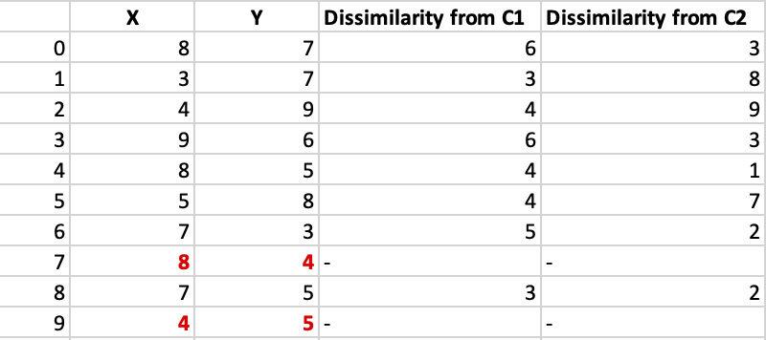
Step 3: randomly select one non-medoid point and recalculate the cost. Let the randomly selected point be (8, 4). The dissimilarity of each non-medoid point with the medoids – C1 (4, 5) and C2 (8, 4) is calculated and tabulated.
Each point is assigned to that cluster whose dissimilarity is less. So, the points 1, 2, 5 go to cluster C1 and 0, 3, 6, 7, 8 go to cluster C2. The New cost = (3 + 4 + 4) + (2 + 2 + 1 + 3 + 3) = 22 Swap Cost = New Cost – Previous Cost = 22 – 20 and 2 >0

Slide 10
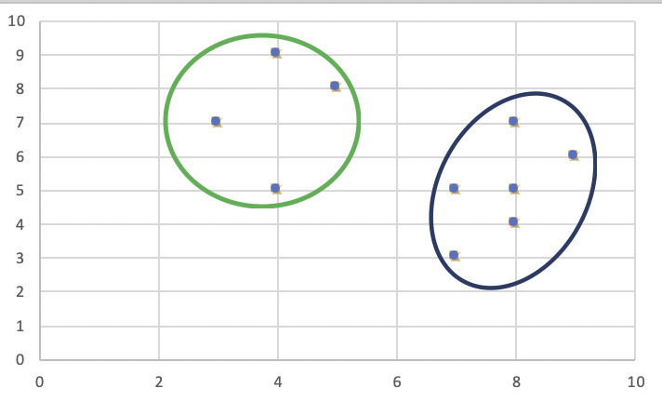
As the swap cost is not less than zero, we undo the swap. Hence (3, 4) and (7, 4) are the final medoids. The clustering would be in the following way

Slide 11
Advantages:
It is simple to understand and easy to implement.
K-Medoid Algorithm is fast and converges in a fixed number of steps.
PAM is less sensitive to outliers than other partitioning algorithms.
Disadvantages:
The main disadvantage of K-Medoid algorithms is that it is not suitable for clustering non-spherical (arbitrary shaped) groups of objects. This is because it relies on minimizing the distances between the non-medoid objects and the medoid (the cluster centre) – briefly, it uses compactness as clustering criteria instead of connectivity.
It may obtain different results for different runs on the same dataset because the first k medoids are chosen randomly.

